Slide 1
Tools Pipeline

Slide 2
Tools used
Git
Stash
Confluence
Jira
Rally
Jenkins
SonarQube
Nexus
Chef
Atomic
ELK
Informatica
Parasoft
App Dynamics
BladeLogic

Slide 3
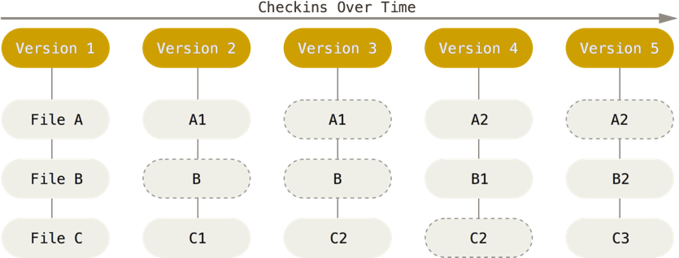
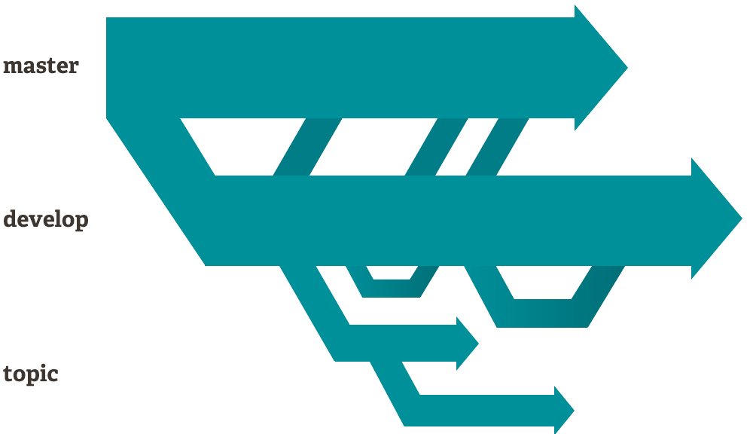
Git
This is a VCS (version control system)
Git stores the data like a set of screenshots. Git takes a “picture” of what your files look like and if you change a file then it will update that file in the version. If you have no changes then it wont store the file again, it will give you a link to the previous identical file.
Git encourages you to have multiple branches that are independent.
Create a branch work on a topic or idea and you could delete this branch or merge the branch to the master.
New branch for new features

Slide 4
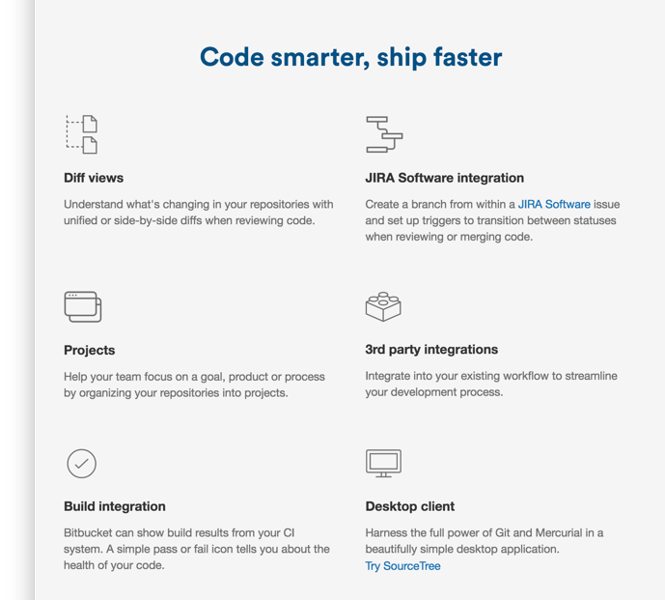
Stash (Bitbucket)
This is a VCS (version control system)
Stash server with add-ons, you can connect with JIRA and confluence software (atlassian software)
Stash is already created inside the bank
Pull requests and branch permissions, works
very similar to Git

Slide 5
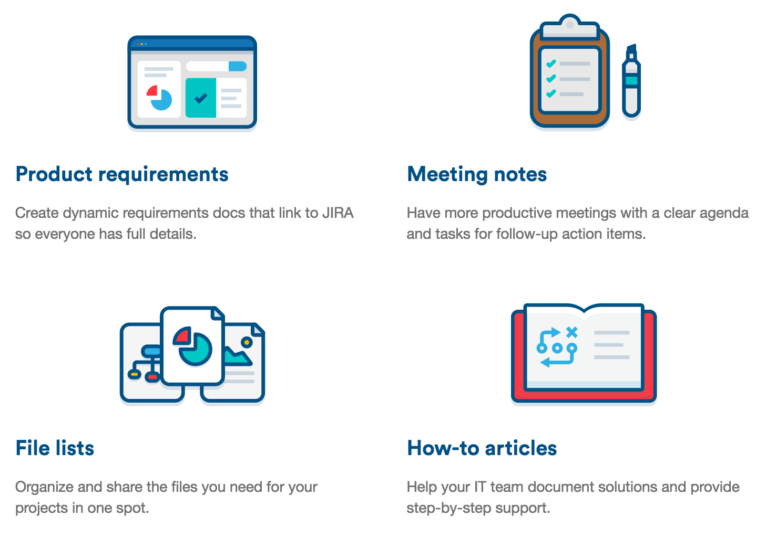
Confluence
This is a team management software
Create, organise and discuss work for your team or project
Make sure all the work is captured in one location rather than emails back and forth.

Slide 6
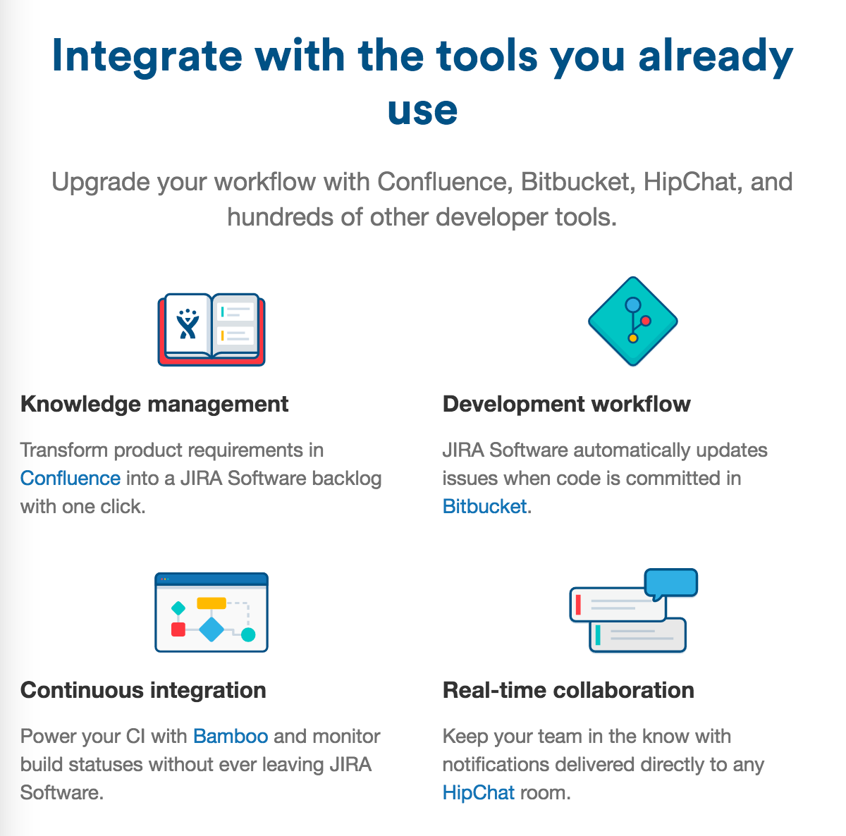
Jira
Jira is built for members of the team to plan, track release software
Plan
You are able to create user stories and issues
Plan your sprints
Track
Be able to priorities work
discuss work that needs to be done
organise work for individuals
Kanban view

Slide 7

Rally
Similar to Jira for project management
Team collaboration\
Agile project management,
Being able to track team/projects progress
Custom dashboards, kanban, or your choice
Burndowns.
Enterprise scale agile
realtime visibility into teams and their progress and work load
connect delivery with plans and business strategy/objectives
delivery and features to meet business goals
Product and portfolio management
strategic plans and roadmaps that can be connected to delivery/projects
align the work with the business investments
use facts to help with reporting status of projects or deliveries/features.

Slide 8
Jenkins
Jenkins is an automation platform that helps with automating build testing and integration
This is a continuous integration and continuous delivery application
Software quality becomes improved, any issues or problems in the code is detected and can be resolved
Easy installation: Just run java -jar jenkins.war, deploy it in a servlet container. No additional install, no database. Prefer an installer or native package? We have those as well.
Easy configuration: Jenkins can be configured entirely from its friendly web GUI with extensive on-the-fly error checks and inline help.
Rich plugin ecosystem: Jenkins integrates with virtually every SCM or build tool that exists. View plugins.
Extensibility: Most parts of Jenkins can be extended and modified, and it's easy to create new Jenkins plugins. This allows you to customize Jenkins to your needs.
Distributed builds: Jenkins can distribute build/test loads to multiple computers with different operating systems. Building software for OS X, Linux, and Windows? No problem.

Slide 9
SonarQube
“It’s a code quality management platform that allows developer teams to manage, track and eventually improve the quality of the source code. It’s a web based application that keeps historical data of a variety of metrics and gives trends of leading and lagging indicators for all seven deadly sins of developers”
Measure and analyse the quality of code
can be confused with jenkins;
Jenkins is a tool to implement continuous integration, it builds and tests code every time a change is made
sonar is a managing code quality tool, this focuses on analysing code

Slide 10
Nexus
This is a repository management system that stores artifacts
They have 2 purposes
highly configurable proxy between organisation and public repositories
they also provide a deployment destination for internal artifacts

Slide 11
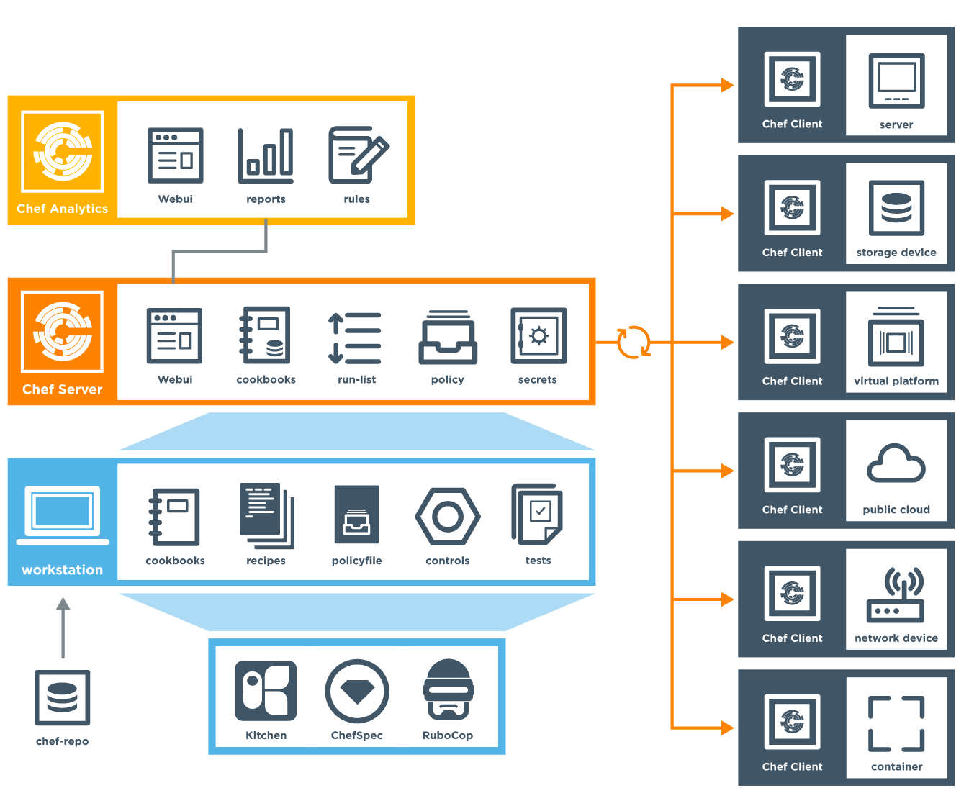
Chef
This is a powerful automation platform that transforms infrastructure into code
Doesn’t matter if you are operating in public cloud, on premises or hybrid
chef automates the configures, deploys, and manages applications across a network
Chef is scalable
more info: https://docs.chef.io/

Slide 12
Automic
Atomic focuses on automation at all levels through a business
This links business processes and services with IT applications and infrastructure that support the process
main reasons to automate processes;
manual hand offs
human error
What they offer
Automic workload automation - create, manage and monitor business applications and IT infrastructure processes
Automic Release automaton - to be able to coordinate application release and deployment beside critical business processes
Automic service orchestration - connect complex services across the business, this includes application and infrastructure layers

Slide 13
ELK
Elastic search
store, search and analyse
Logstash
pipeline to ship and process data
Kibana
explore and visualise
UI, Front-end
this can include dashboards

Slide 14
ELK

Slide 15
What is ELK
Elasticsearch – for deep search and data analytics
Logstash – Centralised logging
Kibana – Powerful for data visualisation, UI

Slide 16
Why is centralising logging useful
It can be very useful when identifying problems with servers or applications.
You will be able to search through all the logs in one place
You can also identify issues that spread across multiple servers

Slide 17



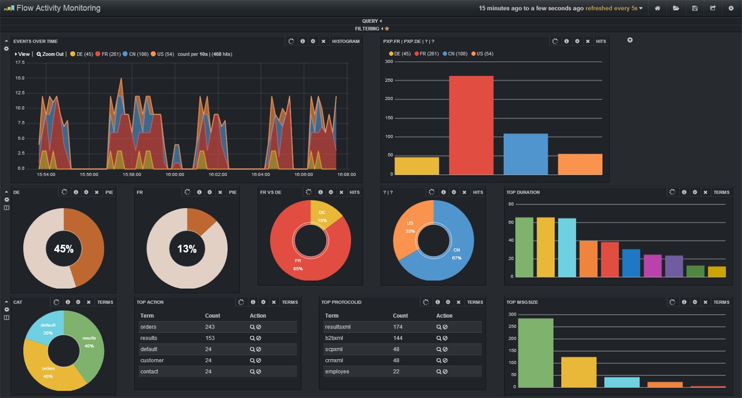
Diagram of ELK
Logs
Logs
Logs
Logs
Logs
Notes:
Logstash - An agent which normally runs on each server you wish to harvest logs from. Its job is to read the logs (e.g. from the filesystem), normalise them (e.g. common timestamp format), optionally extract structured data from them (e.g. session IDs, resource paths, etc.) and finally push them into elasticsearch.
Elasticsearch - A distributed indexed datastore which normally runs in a single cluster. It’s job is to reliably store the incoming log data across the nodes in the cluster and to service queries from Kibana.
Kibana - A browser-based interface served up from a web server. It’s job is to allow you to build tabular and graphical visualisations of the log data based on elasticsearch queries. Typically these are based on simple text queries, time-ranges or even far more complex aggregations.

Slide 18
ELK central logging
Elasticsearch | Kabana
Logstash Indexers
Logstash Indexers
Logstash Indexers
Logstash Indexers
Apps
Apps
Apps
Notes:
Cetralised Elastic search and kibana. If you wanted to index differently to other projects and config the logs you wanted to track then you would need your own logstash indexer. This logstash indexer will then connect to your application.

Slide 19
Elk central logging
We will use logstash-forwarder on each server/apps where we want to harvest the logs. These nodes will send data to the indexer : logstash. This one will process them using filters and send the formatted dataa to elasticsearch.
Kibana, the UI, will allow to display and compile the data. This architecture is scalable, you can quickly add more indexers nodes by adding logstash instances. Same for elasticsearch, which works as a cluster of one node by default.

Slide 20
ELK Image
ELK cookbook
(This cookbook is now being used with automated chef CI pipeline.)
Node
All logs feed into one box (syslog) not secure at the moment.
Go to loans are implementing ELK on IaaS (to be confirmed)
All components can be installed on one node and will talk to each other.

Slide 21
Not secure
Logs are transferred as syslogs, at the moment this is not secure. Barclays is working on adding plugins to make it secure

Slide 22
Logstash Configuration file
Input – this is the mechanism for passing log data to logstash, common used are; syslog, file, lumberjack
Filter – processes the inputs in the logstash, you can add conditions so you can perform certain actions and it has to match a particular criteria
Output – final phase of the logstash pipeline, most common outputs would be elasticsearch, file.

Slide 23
Elasticsearch
Elasticsearch has search and index data that is avaiable RESTfully as JSON over HTTP

Slide 24
Kibana
This is a web interface is a customisable dashboard that can be adjusted to suit your environment
You can query events, create tables, graphs as well as dashboards.
Kibana web interface uses apache Lucene query syntax

Slide 25
Informatica
Informatica is a data integration tool
Informatica provides functionality for export, transform and loading of data

Slide 26
Parasoft
Continous testing
shift testing left - this means earlier testing in the lifecycle
parasoft service virtualisation
create simulated test environments
Parasoft development testing platform (DTP)
reduces risk associated with software development
bridges gap between business and development
automated defect prevention

Slide 27
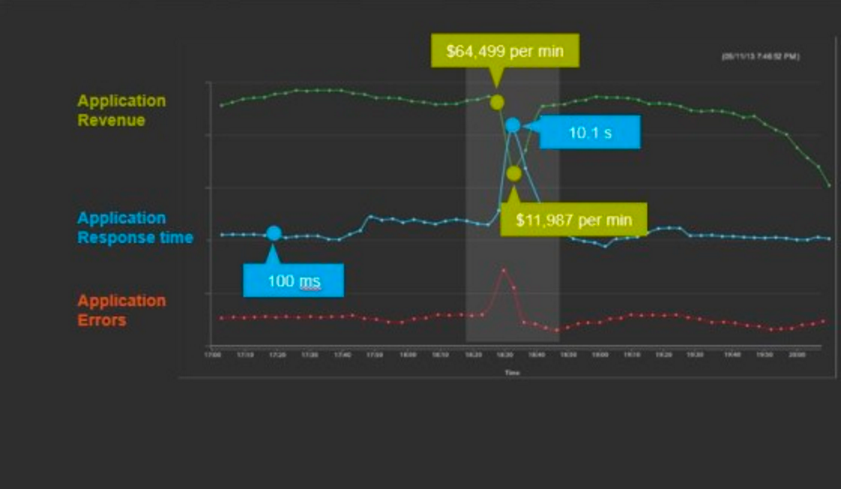
App Dynamics
AppDynamics is an application performing management (APM) tool
this tool allows you to analyse, optimise and predict problems that can occur in information systems
you can add this to both product and testing environments
AppDynamics can be used to find problems, monitor systems and also can be used to analyse impacts. Below is an example of a dashboard.

Slide 28
BladeLogic
This allows you to provision, configure, patch and maintain physical, virtual and cloud servers quicker and securely

